Slide 1

Teh 4 US
A collaborative tool to fulfill all of us
Brought to you
By
Trap Flaggers
CHEN Weixi
LIU Mingxia
LIU Siyuan
Peter TANG
XIE Lekai
ZHANG Jiao

Slide 2
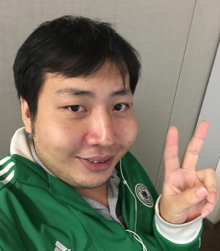
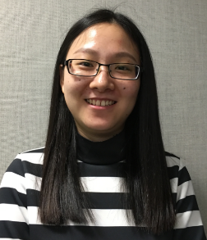
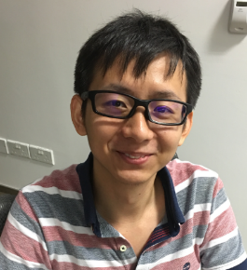
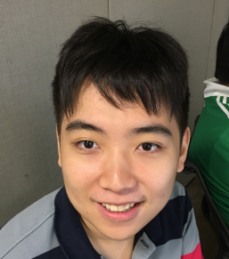

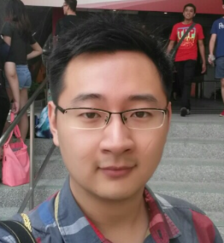
Amazing Team Members
CHEN
Weixi
EngOps
Engineering
Solutions
LIU
Mingxia
Dev
Reality
Solutions
LIU
Siyuan
Dev
AutoCAD
TANG
Peter
EngOps
Engineering
Solutions
XIE
Lekai
Dev
ISM
ZHANG
Jiao
QA
PLM

Slide 3

Project Background
Collaboration starts with
“Hey, want to grab a coffee?”
------
Get to know people and enjoy
Kopi
Teh Milo ..
…
AND
Share IDEAS
Collaboration

Slide 4


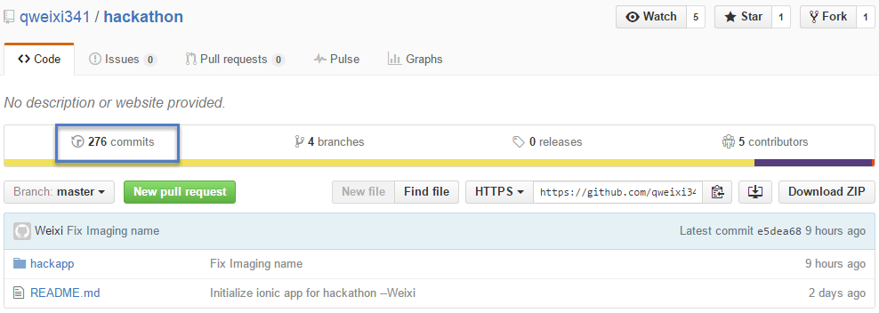
Some interesting numbers
0 Bug
1 APP
2 Platform
1 Git Repo
2 Days
272 Commits

Slide 5
Live Demo

Slide 6
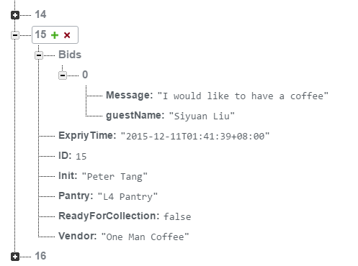
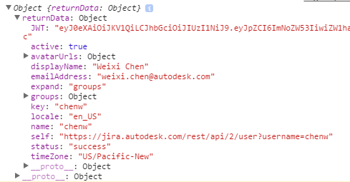
Project Highlight
Autodesk-JIRA API
REST API
JWT Login
Firebase Backend
Asynchronous Calls
Real Time Synchronous Update Push Notification Mobile and Pluggable
IONIC-Dual Platform Support
Ready For Deployment
.
.
.
.
FUN
RELAXING
AWESOME

Slide 7
Q & A

